Slide 1

Revenge of the Synthesis
Star Wars Synthesis Prompt

Slide 2

What does a synthesis essay assess?
Can you go through and pick out the best sources?
Can you differentiate between summary and synthesis?
Can you write a thesis without rephrasing the prompt?
Can you form opinions and articulate them in writing?
Can you use sources to support your own arguments?
Can you imbed quotations into your paragraphs?
Can you identify source information in a citation?
Can you read critically?
Notes:
Can you read critically?
Can you form opinions and articulate them in writing?
Can you cull through sources to find the best sources for your purpose?
Can you identify source information in a citation?
Can you use sources to define, support and refute your own arguments?
Can you differentiate between summary and synthesis?
Can you imbed quotations into your paragraphs?
Can you write a thesis that articulate your argument without rephrasing the prompt?

Slide 3
The synthesis question asks students to synthesize information from a variety of sources to inform their own discussion of a topic. Students are given a 15-minute reading period to accommodate the additional reading required for the question.
What does the synthesis essay require?
Use a minimum of 3 sources in your essay.
Cite your sources using imbedded or parenthetical citations (source A).
Provide commentary that supports your claims & evidence.
Provide a counter-argument.
Take Note!
Notes:
Can you read critically?
Can you form opinions and articulate them in writing?
Can you cull through sources to find the best sources for your purpose?
Can you identify source information in a citation?
Can you use sources to define, support and refute your own arguments?
Can you differentiate between summary and synthesis?
Can you imbed quotations into your paragraphs?
Can you write a thesis that articulate your argument without rephrasing the prompt?

Slide 4
What does the synthesis essay include?
The synthesis prompt is an argument essay that gives you multiple sources and asks you to take a position on the topic. Then you are to use the given sources to support that argument.
Anatomy of a Synthesis Prompt:
Prompt Page
List of sources (typically 7)
Sources (5-6 print, 1-2 visual)
Notes:
Can you read critically?
Can you form opinions and articulate them in writing?
Can you cull through sources to find the best sources for your purpose?
Can you identify source information in a citation?
Can you use sources to define, support and refute your own arguments?
Can you differentiate between summary and synthesis?
Can you imbed quotations into your paragraphs?
Can you write a thesis that articulate your argument without rephrasing the prompt?

Slide 5
AP ENGLISH LANGUAGE AND COMPOSITION FREE-RESPONSE QUESTIONS
ENGLISH LANGUAGE AND COMPOSITION
SECTION II
Total Time - 2 hours
Question 1
Originally released in 1977, Star Wars was a small indie film made by an fairly unknown writer and director George Lucas. The movie changed cinema and Lucas continued the story in two more films. In 1999, Lucas returned to Star Wars to produce three more movies, a trilogy of prequels, that would break box office records and would be met with a tepid response from critics and fans.
When Disney bought the franchise in 2012, the entertainment juggernaut set out to expand beyond the original films, adding another trilogy to the mix. There are several movies, television shows, novels, comic books, animated series that make up the Star Wars extended universe (EU). Still, there are people who have little to no experience with Star Wars and given the overwhelming amount of content, find the Star Wars EU too daunting to enter.
Read the sources carefully and then using at least 3 sources, take a position on the best order to use when watching the films in the Star Wars saga.
Since the synthesis is Question 1, the prompt page will include this title for section II of the test.
Introductory information for the topic of the essay. This is a MUST READ.
DO NOT SKIP!
Welcome to the PROMPT PAGE
Take Note!
TASK: look for the bold font on the prompt page.

Slide 6
Make sure your argument is central; use the sources to illustrate and support your reasoning. Avoid merely summarizing the sources. Indicate clearly which sources you are drawing from, whether through direct quotation, paraphrase, or summary. You may cite the sources as Source A, Source B, etc., or by using the descriptions in parentheses.
Source A (Ebert)
Source B (Rotten Tomatoes)
Source C (Reddit)
Source D (Choi)
Source E (Russell)
Source F (Richter)
Source G (Heller)
Source H (iMDB)
These directions are the same for ALL synthesis prompts. Be sure you follow these directions. Highlight this section on your copy.
Welcome to the PROMPT PAGE (pt 2)
STOP!
Jot down your initial opinion before you read the sources!
List of sources included in the packet in this order. The name of the author or website are in the parentheses.
Take Note!

Slide 7
After you read the the prompt page for your synthesis essay, decide on the following information for your writing task:
Take Note!
Stakeholders (Audience)
  Who are my stakeholders?: This will be the audience for the statement. Who would care about this and why?
Issues (CHASERS)
  At this point, what issues might I consider? What sorts of things might my stakeholders care about?
Content (Purpose)
  Why this information important? How could it help you develop your position?
Thesis (Working-- you might change it after you read the sources)
  If I had to Write a Thesis right now, even though I haven’t looked at any sources, what would it be?
Notes:
Can you read critically?
Can you form opinions and articulate them in writing?
Can you cull through sources to find the best sources for your purpose?
Can you identify source information in a citation?
Can you use sources to define, support and refute your own arguments?
Can you differentiate between summary and synthesis?
Can you imbed quotations into your paragraphs?
Can you write a thesis that articulate your argument without rephrasing the prompt?

Slide 8
These are the thesis templates you are looking for.
Template 1 (Closed)
  (Claim about topic) because (list reason(s)).
Template 2 (Open)
  (Claim(s) about topic) because (list unifying idea/reason).
Template 3 (Open)
  (Concession/counter argument language) (concession/counter claim), (claim about topic you will prove).
Template 4 (Closed)
  (Concession/counter argument language) (concession/counter claim), (claim about topic you will prove) because (unifying idea/reason(s)).
Template 5 (open)
  Since (concession/counter claim), and (insert another counterclaim); however, (claim about topic you will prove) because (unifying idea/reason).
Take Note!
Freitas, Timm. “My BEST Two Tips for Synthesis Thesis Statements | THE GARDEN OF ENGLISH.” YouTube, 2 May 2022, https://www.youtube.com/watch?v=dmfzc-G2g00. Accessed 21 June 2022. (Help us Obi-Won. You’re our only hope.)
Notes:
What information do we get from the source box?
Write a claim for this political cartoon using a rhetorically accurate verb and a THAT clause.

Slide 9
Getting Information out of the sources
Take Note!
While reading the sources, mark (+) for things that may support your argument (–) for things that you may use as a concession. Highlight any SUPER quotes or blurbs. Your quotes should never be more than a sentence long, but if something is said well, USE IT.
Remember, think about your audience and what would matter to them...
For each source, consider the following:
How could it support my argument or provide a counter to my argument?
Anything quotable?
Will I use this source? (as soon as you decide a source isn’t useable-- stop reading and move on!)
Notes:
Can you read critically?
Can you form opinions and articulate them in writing?
Can you cull through sources to find the best sources for your purpose?
Can you identify source information in a citation?
Can you use sources to define, support and refute your own arguments?
Can you differentiate between summary and synthesis?
Can you imbed quotations into your paragraphs?
Can you write a thesis that articulate your argument without rephrasing the prompt?

Slide 10
Film review
Every once in a while I have what I think of as an out-of-the-body experience at a movie. When the ESP people use a phrase like that, they're referring to the sensation of the mind actually leaving the body and spiriting itself off to China or Peoria or a galaxy far, far away. When I use the phrase, I simply mean that my imagination has forgotten it is actually present in a movie theater and thinks it's up there on the screen. In a curious sense, the events in the movie seem real, and I seem to be a part of them.
"Star Wars" works like that. My list of other out-of-the-body films is a short and odd one, ranging from the artistry of "Bonnie and Clyde" or "Cries and Whispers" to the slick commercialism of "Jaws" and the brutal strength of "Taxi Driver." On whatever level (sometimes I'm not at all sure) they engage me so immediately and powerfully that I lose my detachment, my analytical reserve. The movie's happening, and it's happening to me.
What makes the "Star Wars" experience unique, though, is that it happens on such an innocent and often funny level. It's usually violence that draws me so deeply into a movie -- violence ranging from the psychological torment of a Bergman character to the mindless crunch of a shark's jaws. Maybe movies that scare us find the most direct route to our imaginations. But there's hardly any violence at all in "Star Wars" (and even then it's presented as essentially bloodless swashbuckling). Instead, there's entertainment so direct and simple that all of the complications of the modern movie seem to vaporize.
Bibliographic citation:
author; title; genre; date
Source A Ebert, Roger. “Star Wars movie review & film summary (1977).” Roger Ebert [Chicago], 1 January 1977, https://www.rogerebert.com/reviews/star-wars-1977. Accessed 19 June 2022.
Source information
Source text
Welcome to the SOURCES!
Take Note!
Notes:
What information do we get from the source box?
Which of these sentences are “quotable”?
Write a claim statement using a THAT clause.

Slide 11

Fan made graphic.
Bibliographic citation:
author; title; genre; date
Source C “Every Star Wars Movie in Chronological Order : r/PrequelMemes.” Reddit, 28 April 2019, https://www.reddit.com/r/PrequelMemes/comments/bihe1h/every_star_wars_movie_in_chronological_order/. Accessed 19 June 2022.
Source information
Visual Text
Welcome to the SOURCES!
Take Note!
Notes:
What information do we get from the source box?
Which of these sentences are “quotable”?
Write a claim statement using a THAT clause.

Slide 12
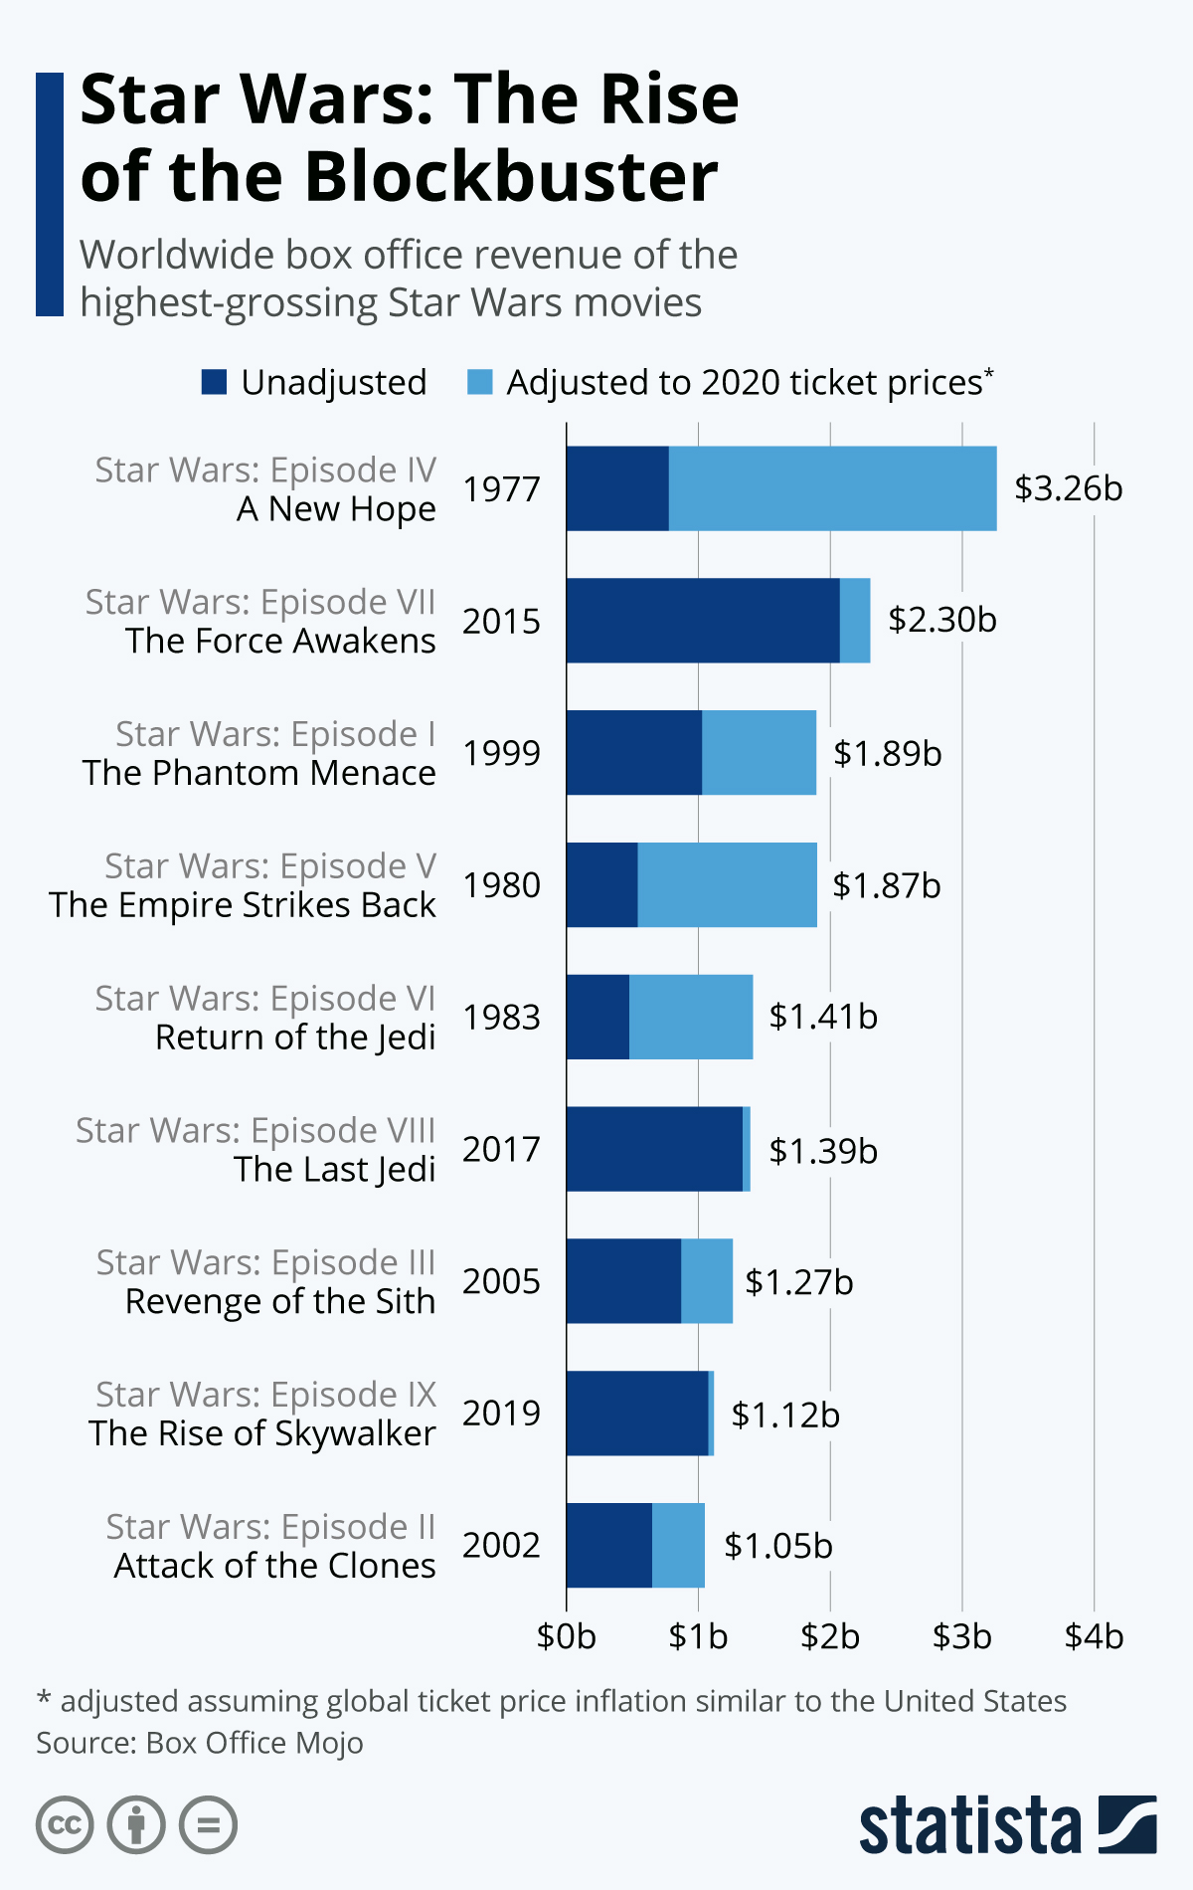
Graph about box office
Bibliographic citation:
author; title; genre; date
Source F Richter, Felix. “Infographic: Star Wars: The Rise of the Blockbuster.” Statista, 3 May 2022, https://www.statista.com/chart/20306/star-wars-box-office-results/. Accessed 20 June 2022.
Source information
Visual Text
Welcome to the SOURCES!
Take Note!
Notes:
What information do we get from the source box?
Which of these sentences are “quotable”?
Write a claim statement using a THAT clause.

Slide 13
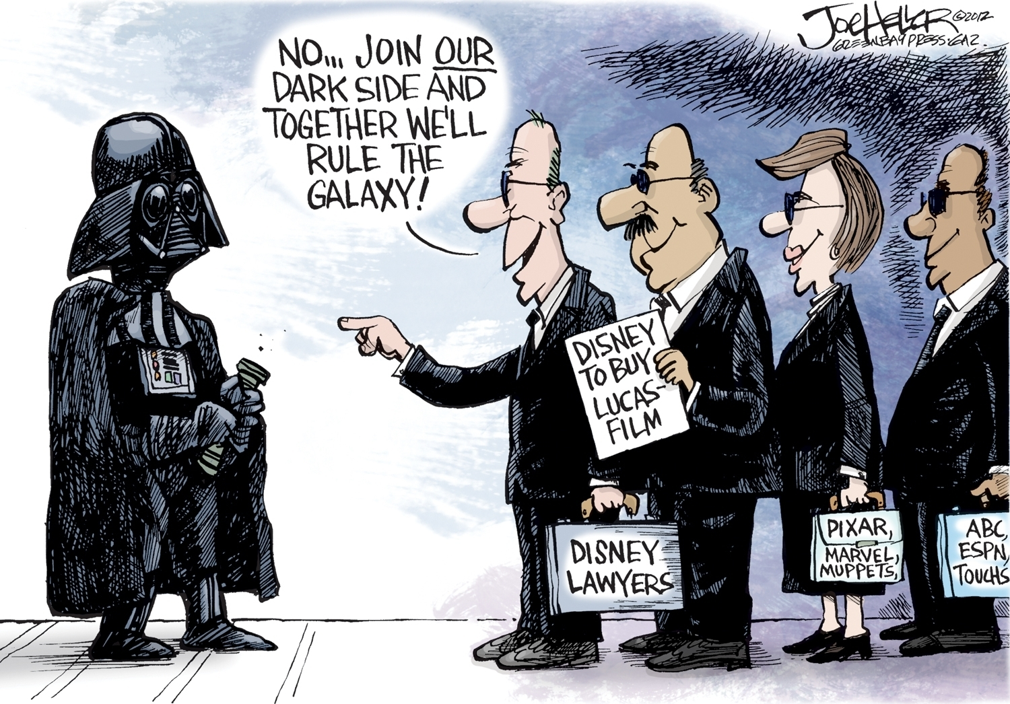
Political cartoon
Bibliographic citation:
author; title; genre; date
Source G Heller, Joe. “Double Take 'Toons: It's A Small Galaxy After All.” NPR, 2 November 2012, https://www.npr.org/2012/11/02/164096338/double-take-toons-its-a-small-galaxy-after-all. Accessed 19 June 2022.
Source information
Visual Text
Welcome to the SOURCES!
Take Note!
Notes:
What information do we get from the source box?
Which of these sentences are “quotable”?
Write a claim statement using a THAT clause.

Slide 14
On your copy of the the prompt that I gave you-- identify the following by highlighting on the document and answer the questions on your prompt page..
The introduction & specific prompt.
  Restate the prompt as a question and answer it with a YES or NO
  List 3 reasons you have for this position
  Write a WORKING THESIS for this essay
The sources and authors/identifiers.
HIghlight Bibliographic citation (for each source)
  And underline the following:
    Author
    Title
    Date
+ sources that support your position
‒ sources that DO NOT support your position.
★ sources that provide counter-argument.
✔ sources that you will not use at all.
For each source, write a claim statement using a rhetorically accurate verb and a THAT clause.

Slide 15
Synthesis Party
You are a host at Mos Eisley Cantina. It is your job to seat the guests as they enter. 6-8 people have walked in and require at most 4 tables. As the host, it is your job to decide where and with who they will sit. Since this is "wretched hive of scum and villainy" you want everyone to get along so no one gets shot.
Read through the sources
Decide where each of the source will sit in the cantina.
Who do you want sitting closest to you? Who do you want sitting away from you? Who do you think will get along? Who will not?
Place the sources letters in the boxes according to where you want them to sit.

Slide 16
Chronology
Machete
B, C,
E, I
Synthesis Party
You are organizing the sources based on the claims in the source.
This is one way to organize the sources. It would entirely depend on the prompt and topic. Maybe the table names are something like Agree With Me/ Disagree with Me/ Counter-Argument/ Concession.
Hint: Organizing by ideas, not genre or kind of source.
Kicked out for cutting off he arm of a customer with a lightsaber. G
D, H,
A, H
Release Date
Doesn’t matter

Slide 17
1. Revise your thesis statement. Can you think of an anecdote to lead into it? Revise your stakeholders if necessary. Who will you be thinking about as your writing? Who would care? Any new revelations?
2. Briefly outline your support paragraphs--remember to begin each with a claim reflecting your position.
In a synthesis essay, you should always consider opposing views
*Where will you include each source?
*What additional evidence could you include?
3. Remember that your ability to show a conversation between the sources is evidence of more complex thinking.
*Where could you include two sources that both support a particular position?
*Where could you evaluate two or more sources that address the same issue?
*How could you contrast two sources that show differing views?
Take Note!

Slide 18
REMINDERS!
In your response you should do the following:
Respond to the prompt with a thesis that presents a defensible position.
Select and use evidence from at least 3 of the provided sources to support your line of reasoning. Indicate clearly the sources used through direct quotation, paraphrase, or summary. Sources may be cited as Source A, Source B, etc., or by using the description in parentheses.
Explain how the evidence supports your line of reasoning.
Use appropriate grammar and punctuation in communicating your argument.
REVIEW!
Did you have an introduction which led into a clear thesis that states your position?
Did you use and cite a minimum of 3 sources?
Did you make sure YOUR argument was central and you used the sources to support YOUR argument? (NO TOUR OF THE SOURCES!)
Did you keep in mind your intended audience and use support and counter arguments which would appeal to them?
Take Note!

Slide 19
Tricks and Tips:
Don’t read every single source. As soon as you know you aren’t going to use it, skip it.
Make your argument central, not the sources.
Decide on your position on the topic before you read the sources.
Outline your essay.
Think of how your sources would talk to one another.
  Who agrees with you?
  Who disagrees with you?
  Who would agree or disagree with part of your argument?
Use 2 sources per body paragraph (CeESESS)

Slide 20
Introduction: Hook, background, thesis
Claim (reasons that support thesis)
  Elaboration
  Evidence
    Source Introduction
    Source Citation
  Support
  Evidence
    Source Introduction
    Source Citation
  Support
  Significance (tie claim back to thesis)
Repeat the same structure for paragraph 2
Conclusion: DO NOT SUMMARIZE. Think about what you hope changes with regard to this topic.

Slide 21
1 point Responds to the prompt with a thesis that presents a defensible position.
3 points EVIDENCE: Provides specific evidence from at least three of the provided sources to support all claims in a line of reasoning. AND COMMENTARY: Explains how some of the evidence supports a line of reasoning. | 4 points EVIDENCE: Provides specific evidence from at least three of the provided sources to support all claims in a line of reasoning. AND COMMENTARY: Consistently explains how the evidence supports a line of reasoning.
1 point Demonstrates sophistication of thought and/or a complex understanding of the rhetorical situation. Responses that earn this point may demonstrate sophistication of thought and/or a complex understanding of the rhetorical situation by doing any of the following: 1. Crafting a nuanced argument by consistently identifying and exploring complexities or tensions across the sources. 2. Articulating the implications or limitations of an argument (either the student’s argument or arguments conveyed in the sources) by situating it within a broader context. 3. Making effective rhetorical choices that consistently strengthen the force and impact of the student’s argument throughout the response. 4. Employing a style that is consistently vivid and persuasive.
AP Synthesis Rubric

Slide 22
